Slide 1
Demographic Trends and Housing in Virginia
Virginia Housing Commission
July 2025
Hamilton Lombard
hamilton.lombard@virginia.edu

Slide 2
Presentation Overview
Recent population trends in Virginia
Examining the connection between housing & demographics
How demographics may influence housing demand in the 2020s

Slide 3
Virginia’s population growth has rebounded from record lows
During the late 2010s and early 2020s, Virginia’s population grew at its slowest rate since the Civil War.
In 2024, Virginia added the largest number of new residents in over a decade.
In recent decades, Virginia’s population growth has slowed when the national economy is strong and interest rates are low.
Change since July 1 of the previous year, source: Census Estimates

Slide 4
The recent surge in immigration has fueled much of Virginia’s growth
Between 2022 and 2024, immigration to the U.S. surged, reaching the highest levels on record in 2024.
Since 2021, expanded federal humanitarian programs have tripled the number of authorized immigrants admitted to the U.S. compared to a decade ago.
Most recent immigrants have been concentrated in large metro areas, helping boost the population of Northern Virginia.
International Migration to Virginia, 2011-2024, source: Census Estimates

Slide 5
For the first time since 2013, Virginia is gaining more residents from other states than it’s losing
For the past decade, Virginia has lost more residents to other states than it gained, due in part to relatively weak economies in its two largest metro areas and high housing costs in Northern Virginia.
Virginia’s return to attracting residents from other states helped raise its annual population growth rate to the highest level in over a decade.
Virginia Domestic Migration, 2010-2024 , source: Census Estimates

Slide 6
Growth in Virginia is being driven by increased migration to areas outside the Urban Crescent
Migration to Richmond and many of Virginia’s small metro areas has steadily risen in recent years.
Most rural counties, including much of Southside and Southwest Virginia are now attracting more new residents than they are losing.
Northern Virginia continued to experience out-migration in 2024, marking an ongoing shift from its historic pattern of attracting new residents from other states.
Annual domestic migration by Virginia MSA , source: Census Estimates

Slide 7
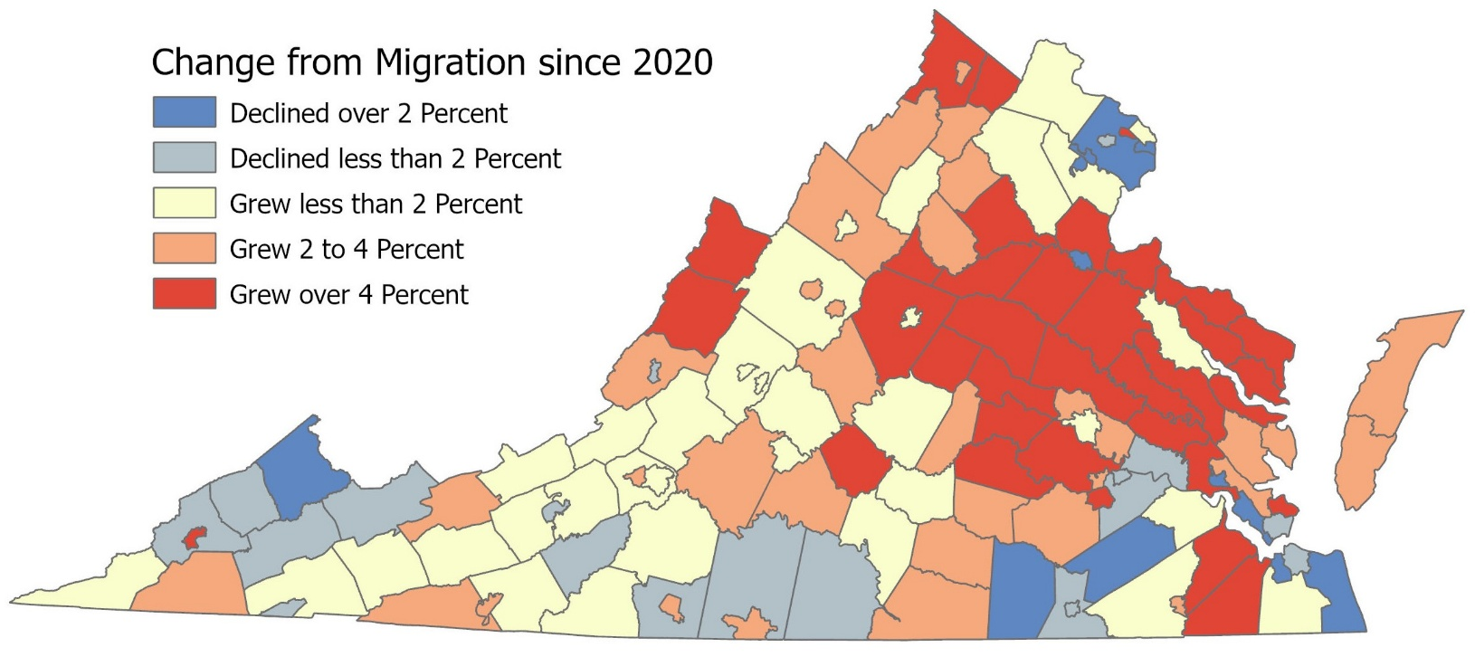
A record number of Virginia’s communities are attracting new residents
In 2024, a record-high 90% of Virginia localities outside its three biggest metro areas (Hampton Roads, Northern Virginia, and Richmond) attracted more new residents than they lost.
Despite the surge in immigration in recent years, Virginia’s largest county and city have lost more residents than they’ve gained.
Declined over 2%
Declined less than 2%
Grew less than 2%
Grew 2% to 4%
Grew more than 4%
Change in Population from Migration since 2020 , source: Weldon Cooper estimates

Slide 8
Since 2020 many small towns and rural counties have continued to gain residents
Nationally, migration has increased to exurban counties on the edges of metro areas, such as Orange County, and to areas with natural amenities, including Middlesex County.
In 2024, a combination of factors, including the persistence of remote work, a strong economy and high housing prices in large metro areas have led many Americans to continue to move to small towns and rural counties across the country.
# of U.S. Counties with Positive Domestic Migration (Populations under 100K) MSA , source: Census Estimates

Slide 9
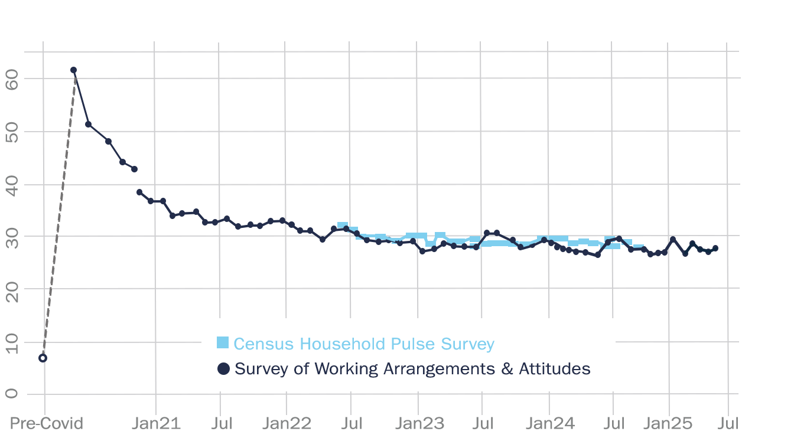
Remote work continues to give workers more freedom in where they live
Last month, 27 percent of full days were worked remotely in the U.S., approximately four times more than before the pandemic.
Between 2019 and 2022, the number of Virginians working in the Washington, D.C., Metro Area but living elsewhere in Virginia increased by nearly 24,000.
The increase in remote workers in Virginia’s rural counties and small metro areas is diversifying their economies.
Share of Paid Full Days Worked from Home from Stanford University WFH Research

Slide 10
New business growth in Virginia has remained strong outside its largest metro areas
Between 2019 and 2024 in Virginia, new business applications have increased 28 percent more in Southside and 19 percent more in rural Chesapeake Bay counties compared to Virginia’s statewide average.
Nationally, new businesses have formed at the highest rates in counties with strong economies and a relatively low cost of living.
Change in new business applications between 2019 and 2024 by region in Virginia, source: IRS Business Applications

Slide 11
High housing costs and interest rates are driving more people to affordable metro areas.
Nationally, migration remained elevated in 2024 from most metro areas with high housing costs.
In the first quarter of 2025, migration from high cost U.S. metro areas was 58 percent higher than before the pandemic.
As home prices have risen, migration has increased to lower cost metro areas, such as Bristol and Roanoke.
Change in Home Values using Zillow Single Family Home Value Estimates

Slide 12
Presentation Overview
Recent population trends in Virginia
Examining the connection between housing & demographics
How demographics may influence housing demand in the 2020s

Slide 13
Young adult homeownership has grown fastest outside Virginia’s big metros
With a stronger economy, U.S. homeownership rates have risen in recent years, especially in rural counties and small metro areas.
Rising housing costs in Northern Virginia and other expensive metro areas have made homeownership harder, driving migration to more affordable areas where young adults are more likely to own homes.
Share of Millennials who own homes, source: Census American Community Survey

Slide 14
Younger adults have driven most of the migration to more affordable parts Virginia
Since 2020, adults between age 25 and 44 have contributed to nearly two-thirds of Virginia’s population growth outside its three largest metro areas.
In Northern Virginia, 80 percent of its population growth has come from its population age 65 and older since 2020.
Change in population, ages 25 to 44, by VA MSA, source: Census Estimates

Slide 15
As more families leave Northern Virginia, its child population is shrinking
Across the country, high-cost metro areas are seeing sharp declines in their child populations as families move to more affordable regions.
Although birth rates have declined across Virginia, Northern Virginia has seen the largest percentage drop in births over the past decade.
Declining youth populations in high-cost metro areas will eventually slow their labor force growth or cause it to shrink.
Change in population, under age 5, by VA MSA, source: Census Estimates

Slide 16
Homebuilding continued to rise in more affordable parts of Virginia in 2024
In 2024, nearly 60 percent more homes were permitted for construction outside Virginia’s three largest metro areas than in 2019.
Despite the increase in new home construction, 2024 levels were below the 2000s average in every Virginia metro area except Winchester.
The loss of construction workers since the 2000s has made it difficult for many communities to increase the supply of homes.
Single family homes permitted for construction annually, source: Census Building Permit Survey

Slide 17
Since the pandemic, homebuilding has surged in states south of Virginia.
The upper South has been among the fastest growing parts of the country since 2020.
Between 2019 and 2024, West Virginia and North Carolina had the third and fourth largest percentage increases in new home construction.
Much of southern Virginia is experiencing spillover growth from North Carolina and Tennessee, boosting the demand for housing.
Virginia | 2024 Permits Issued | Change in Permits Since 2019 |  | Mid-Atlantic | 2024 Permits Issued | Change in Permits Since 2019
Lynchburg | 967 | 707 |  | Wilmington, NC | 7,263 | 5,313
Richmond | 5,023 | 542 |  | Charlotte, NC | 18,954 | 2,701
Winchester | 1,031 | 312 |  | Greenville, SC | 7,826 | 2,441
Harrisonburg | 629 | 268 |  | Raleigh, NC | 12,277 | 2,235
Bristol | 701 | 248 |  | Charleston, SC | 6,817 | 2,059
Staunton | 481 | 169 |  | Knoxville, TN | 4,845 | 1,860
Blacksburg | 481 | 128 |  | Hickory, NC | 2,310 | 1,613
Roanoke | 541 | 77 |  | Burlington, NC | 1,999 | 1,056
Charlottesville | 985 | -11 |  | Winston-Salem, NC | 4,010 | 850
Hampton Roads | 3,544 | -801 |  | Chattanooga, TN | 2,607 | 746
Washington DC | 11,743 | -1,234 |  | Lynchburg, VA | 967 | 707
Top MSAs by Growth in Single Family Construction since 2019 source: Census Building Permit Survey

Slide 18
Presentation Overview
Recent population trends in Virginia
Examining the connection between housing & demographics
How demographics may influence housing demand in the 2020s

Slide 19
In 2023, more young adults lived independently despite high housing costs.
A tight labor market and strong economy have enabled more young adults to work, earn higher incomes, and live independently.
Since 2020, fewer US adults aged 18–34 are living with parents or roommates, while more are living alone or with a spouse, boosting the demand for housing.
Share of Virginians age 18-34-living alone or with spouse/partner, source: Census microdata

Slide 20
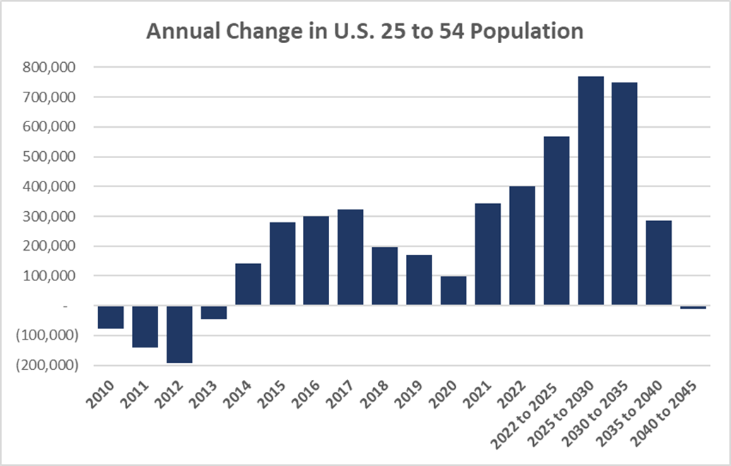
Demographic trends will help support housing demand for the next decade
Over the next decade, strong growth in the age groups that include most first-time homebuyers will help drive additional housing demand.
The steady decline in births since the mid-2000s means that, without higher immigration levels, younger household growth will stall in the 2040s.
Change in U.S. population between ages 25 and 54, source: Census estimates and projections

Slide 21
Growth in older households will continue to be a major force in the housing market
Since 2010, seniors have accounted for over 80% of the growth in owner-occupied households in the U.S.
The rapid growth of older households, which on average have the highest spending power, has had widespread impacts on the housing market.
Over the next decade, most of Virginia’s population growth is expected to come from people aged 65 and older.
Cumulative change in Owner Occupied Households by Age of Household, source: Census ACS

Slide 22
Outside early adulthood, a large majority of Americans opt to live in detached homes
Relatively few older adults downsize, close to eighty percent of eighty-year-olds live in single family homes.
U.S. families with children are nine times more likely to live in detached homes than in apartments or condos.
Demand will likely continue to be strongest for single family homes, even in Virginia’s larger, denser metro areas.
Distribution of Americans by housing type and age, source: Census Microdata

Slide 23
Concluding Thoughts
As the U.S. population ages, more communities are competing to keep and attract workers. Quality of life, especially housing affordability, increasingly determines whether communities grow or shrink.
Young adults are the most mobile age group, losing them and their families poses a long-term economic risk to high-cost metro areas.
Strong growth among both seniors and younger adults will continue to support housing demand over the next decade.

Slide 24
Demographic Trends and Housing in Virginia
Virginia Housing Commission
July 2025
Hamilton Lombard
hamilton.lombard@virginia.edu

