Slide 1
Examining the Shift in Virginia's Population Trends Since 2020
Virginia Housing Commission
July 15, 2024
Hamilton Lombard, University of Virginia
hamilton.lombard@virginia.edu

Slide 2
Virginia’s population growth is rebounding from pandemic lows
The number of deaths in Virginia has fallen since 2021.
Births in Virginia have continued to decline since the pandemic.
Immigration to Virginia and the U.S. has risen in recent years.
Migration out of Virginia lessened in 2023, though it remains higher than before the pandemic.
Virginia annual population change from July 1 of the previous year

Slide 3
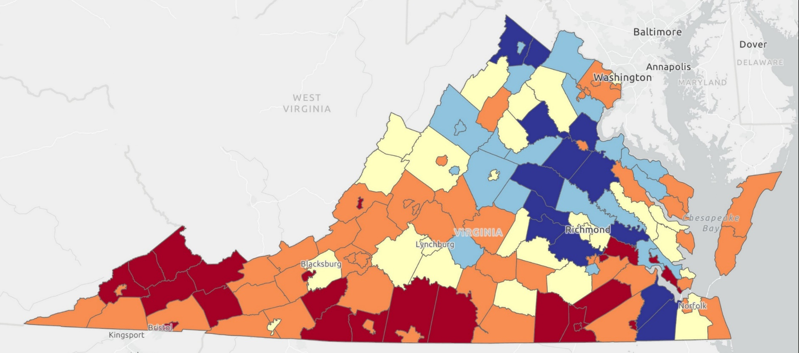
Growth since 2020 remains concentrated in Virginia’s largest metro areas.
Population growth since 2020 has been strongest on the edges of the Urban Crescent.
Many rural counties also continued to lose population in 2023.
Both Fairfax County and Virginia Beach continued to lose population in 2023.
Declined over 2%
Declined 0% to 2%
Grew 0% to 2%
Grew 2% to 4%
Grew more than 4%
Population Change: 2020 to 2023

Slide 4
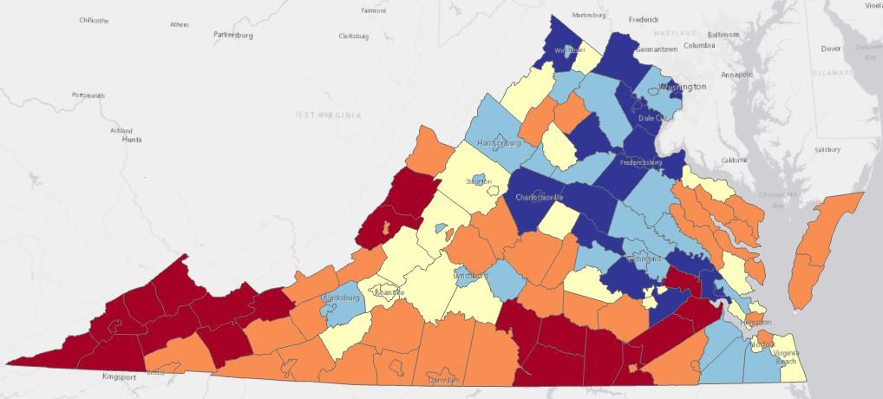
During the 2010s, the Urban Crescent contributed to 90 percent of Virginia’s growth
Northern Virginia accounted for three-fifths of Virginia’s growth during the 2010s.
The large majority of rural counties lost population during the last decade.
Declined over 2%
Declined 0% to 2%
Grew 0% to 2%
Grew 2% to 4%
Grew more than 4%
Population Change: 2010s, 3 Year Average

Slide 5
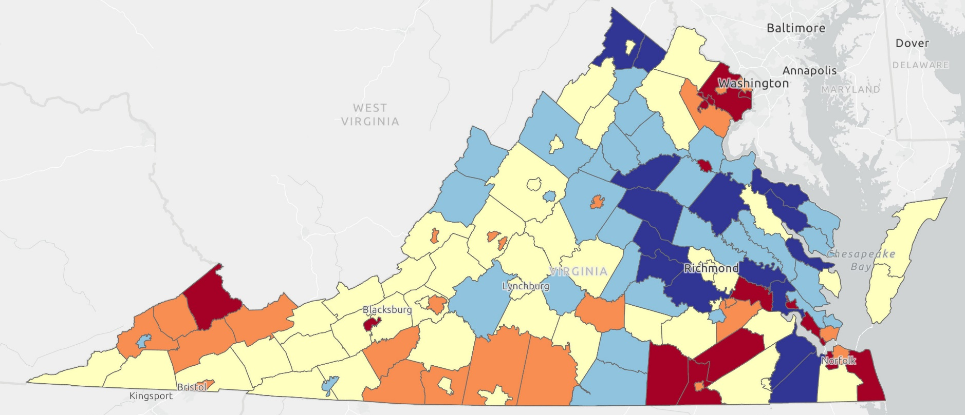
High death rates are masking a significant shift in Virginia’s migration trends
Since 2020, the number of rural Virginia counties attracting new residents has reached its highest level in 50 years.
The Richmond Metro Area is attracting new residents at the highest rate in its history.
Both Hampton Roads and Northern Virginia continued to experience outmigration in 2023.
Declined over 2%
Declined 0% to 2%
Grew 0% to 2%
Grew 2% to 4%
Grew more than 4%
Population Change from Migration, 2020 to 2023

Slide 6
The pandemic accelerated pre-existing migration trends
High housing prices and a strong economy in other parts of the country were already causing more people to leave Northern Virginia before the pandemic.
In the late 2010s, the same factors were increasing migration into the Richmond MSA and most of Virginia’s rural counties and small metro areas.
Net Migration by Region in Virginia

Slide 7
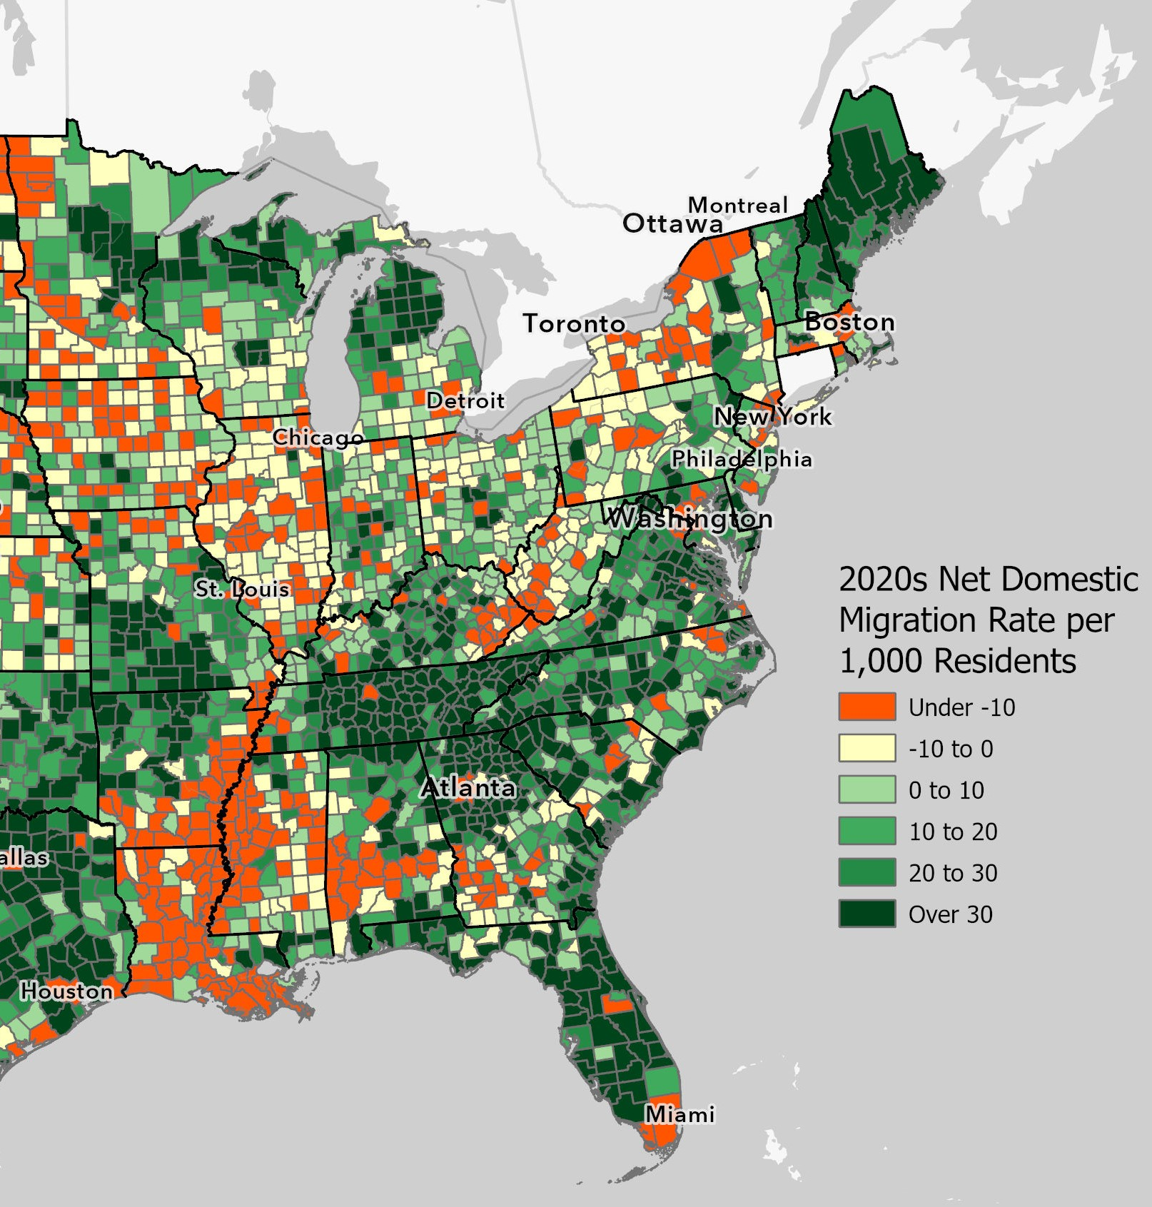
The rest of the country is experiencing similar demographic trends as Virginia
Most of the country’s largest metro areas have experienced out-migration since 2020.
Many smaller metro areas and rural counties have seen in-migration rise since 2020.

Slide 8
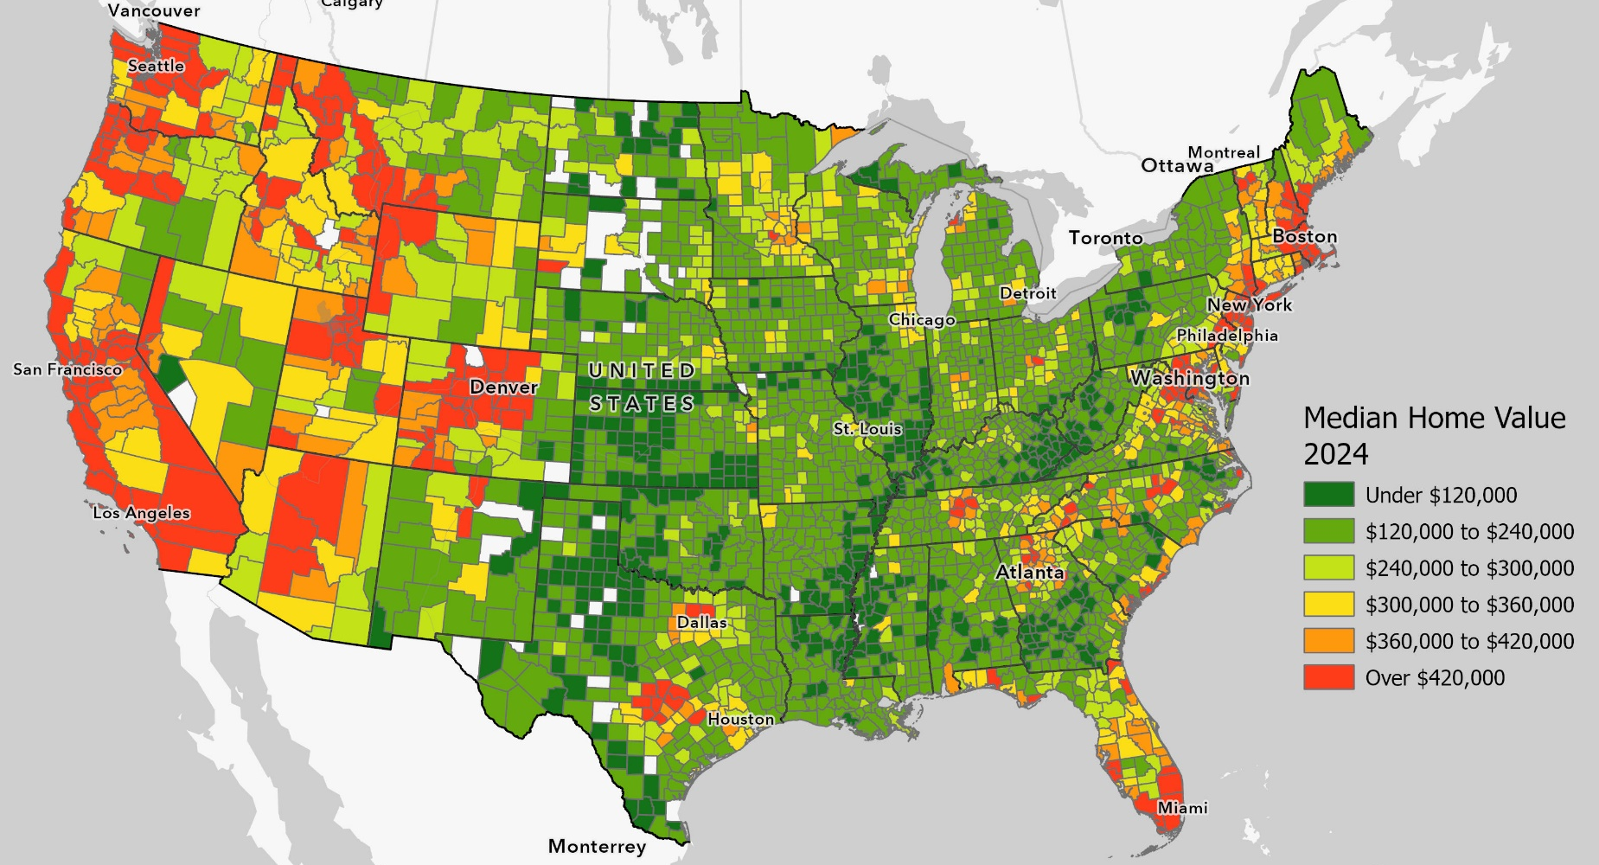
Significant regional differences in home prices are helping fuel current migration trends
The difference in housing prices between Northern Virginia and the rest of Virginia is high by historic standards.
Home values and rent in Northern Virginia counties are among the highest in the country, outside California.

Slide 9
In 2023, there were few signs of a return to pre-pandemic migration trends
Annual Domestic Migration for U.S. Counties with over 1 Million Residents
Annual Domestic Migration for U.S. Rural Counties

Slide 10
In 2023, rural counties & small metros became the top destination for Americans who moved
Since 2020, the DC region has had the highest out-migration rate among Virginia’s metro areas, while the Bristol region has had the highest in-migration rate.
In 2023, the Martinsville region had the second highest in-migration rate among Virginia’s statistical areas.

Slide 11
A surge in household formation is helping fuel housing demand
With a stronger economy, particularly for younger workers, household formation is outpacing population growth in Virginia & the U.S.
Between 2019 and 2022, the number of Virginians age 18 to 34 who live alone rose by over a third or close to 50,000.
Percent of Virginians Ages 18 to 34 Who Live with a Partner or Alone

Slide 12
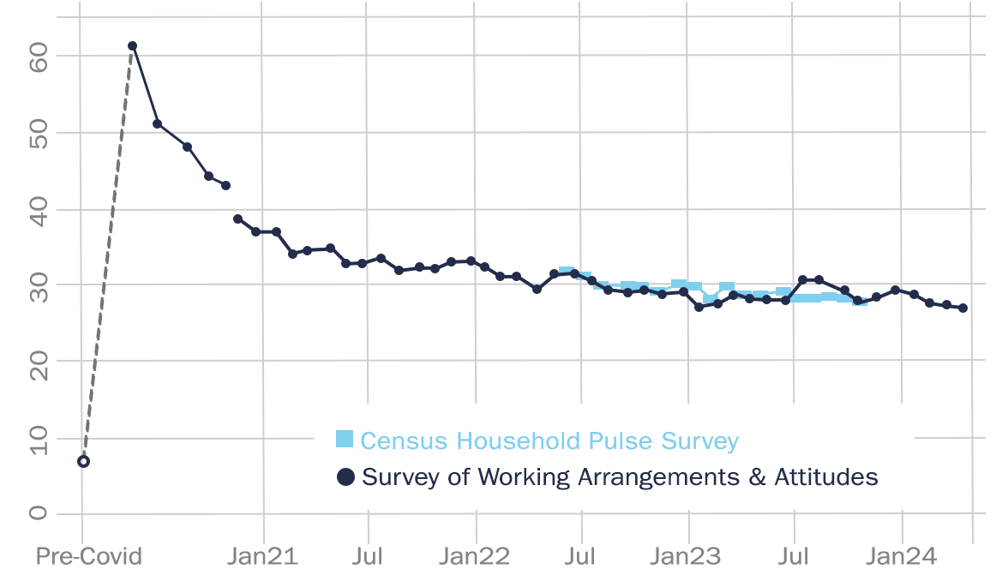
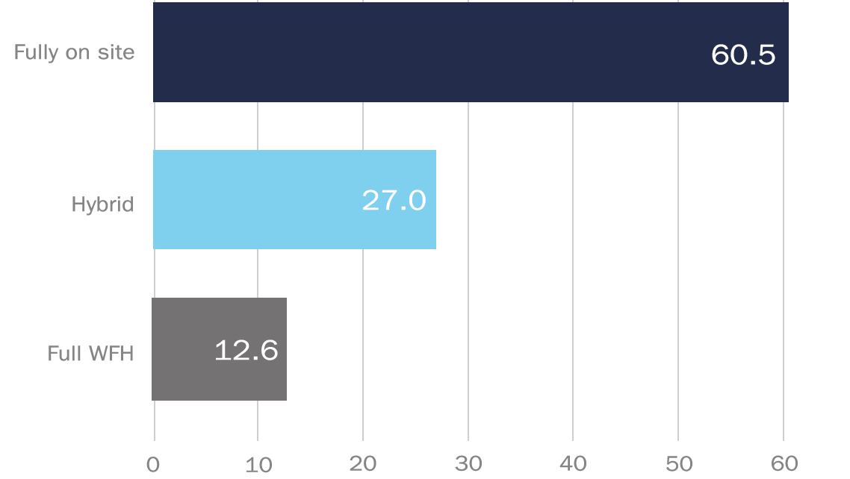
The persistence of remote work is providing many Americans with more flexibility in where they live
Percentage of paid full days worked remotely nationally
Working arrangement (percent employees)

Slide 13
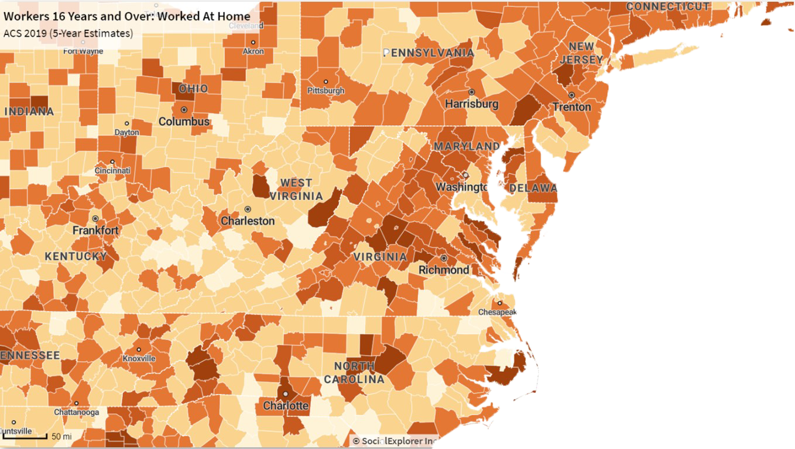
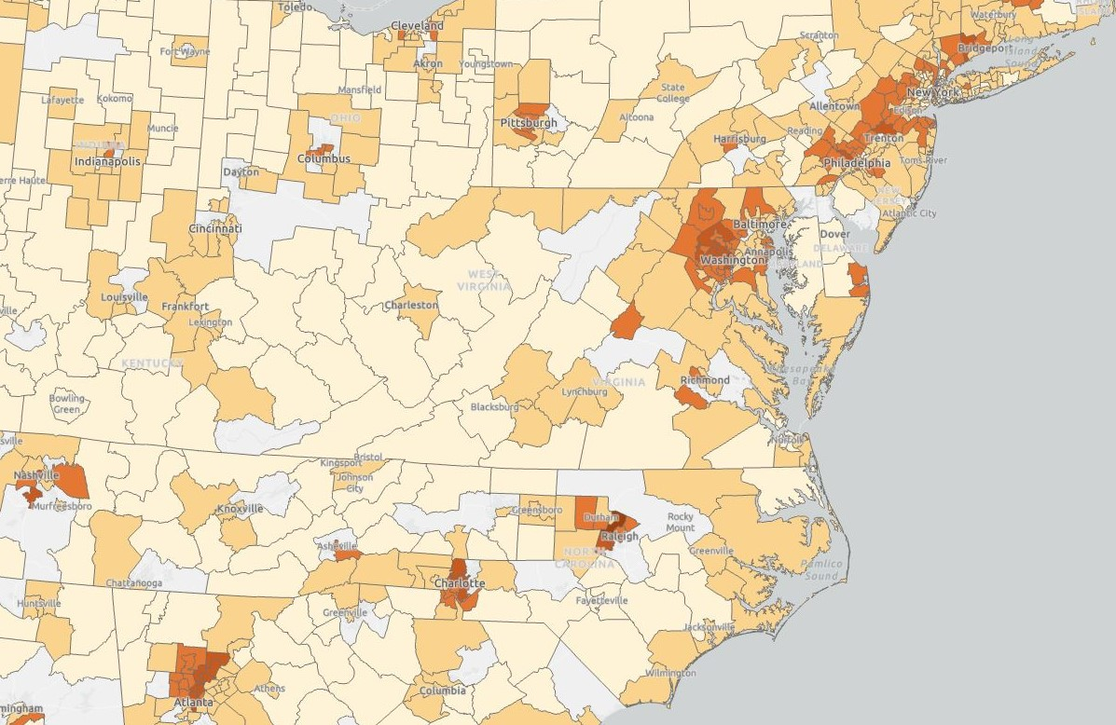
Most remote workers continue to live near large cities…
2019
2022
Insufficient data
< 2%
2% to 4%
4% to 6%
6% to 8%
> 8 %
< 10%
10% to 20%
20% to 30%
30% to 40%
> 40%
Percent of all workers who are fully remote

Slide 14
Though remote workers are increasingly driving growth outside large metro areas
In 2022, remote workers made up a disproportionate share of homebuyers in Richmond, as well as in Virginia’s small metro areas and rural counties.
In 2022, new residents in rural U.S. counties were two-thirds more likely to work remotely than existing residents.
Since 2019, the number of white collar workers has risen nearly twice as fast outside Virginia’s Urban Crescent than its three largest metro areas.

Slide 15
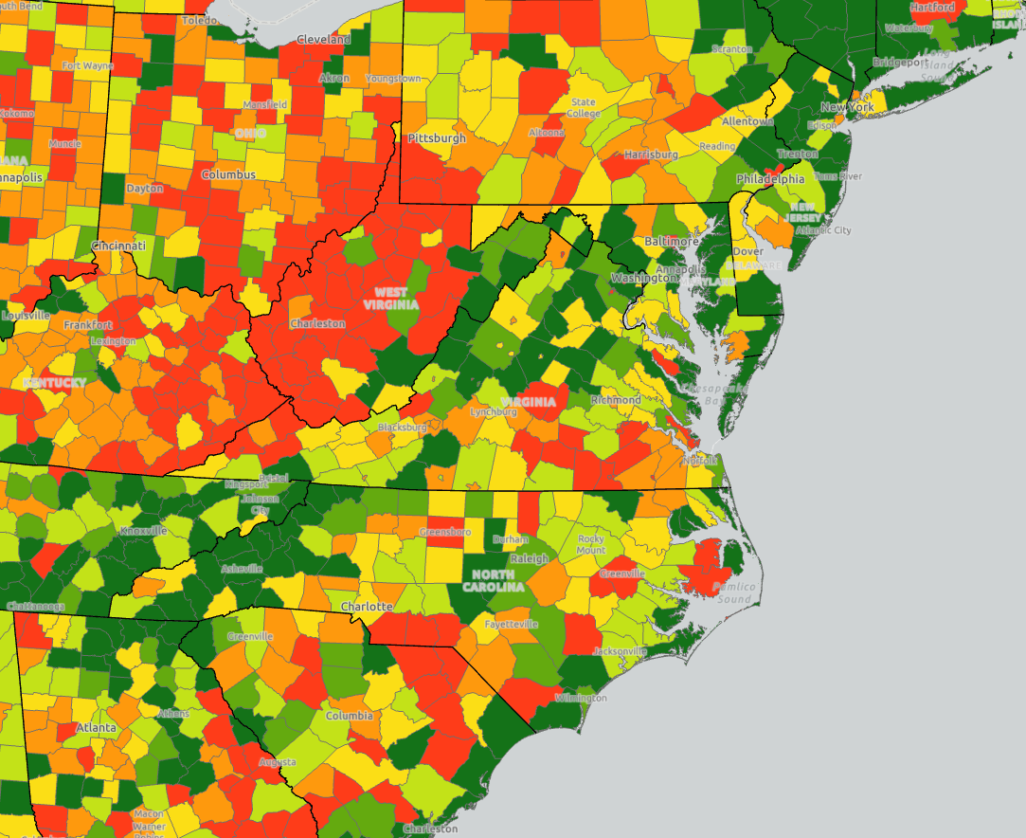
Change in Income of New Residents, 2018-2019 to 2021-2022
Outer suburban counties and rural recreation counties are both attracting more working adults, many of them remote workers, helping boost local income levels and regional housing markets.
Declined
Increased 0 to $2K
Increased $2K to $4K
Increased $4K to $6K
Increased $6K to $8K
Increased over $8K

Slide 16
Home construction rose outside the Urban Crescent in 2023, even as construction fell elsewhere
In 2023, new home construction rose in Virginia rural counties and small metro areas, even as rising interest rates lowered construction levels nationally and statewide.
In 2023, Richmond Metro Area built the second largest number of new homes in its history.
Percent Change in Residential Units Constructed since 2000

Slide 17
New business creation in Virginia has risen the fastest outside the Urban Crescent
With a stronger economy, new business formation has surged across the country.
Rural counties and small metro areas around the U.S. and in Virginia have seen the largest increases in business creation since the pandemic.
Increase in the number of new businesses formed annually between 2019 and 2023 by region

Slide 18
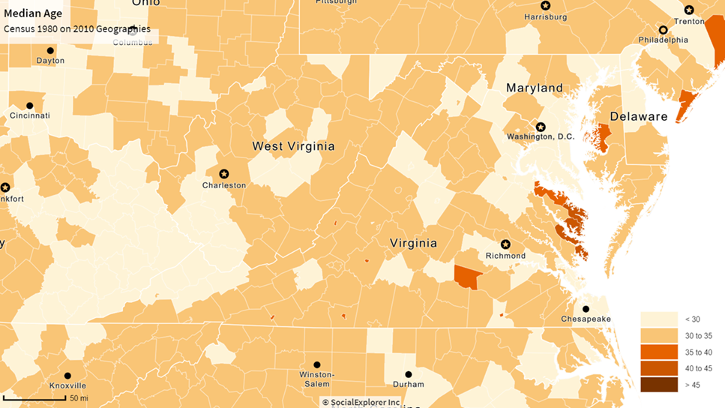
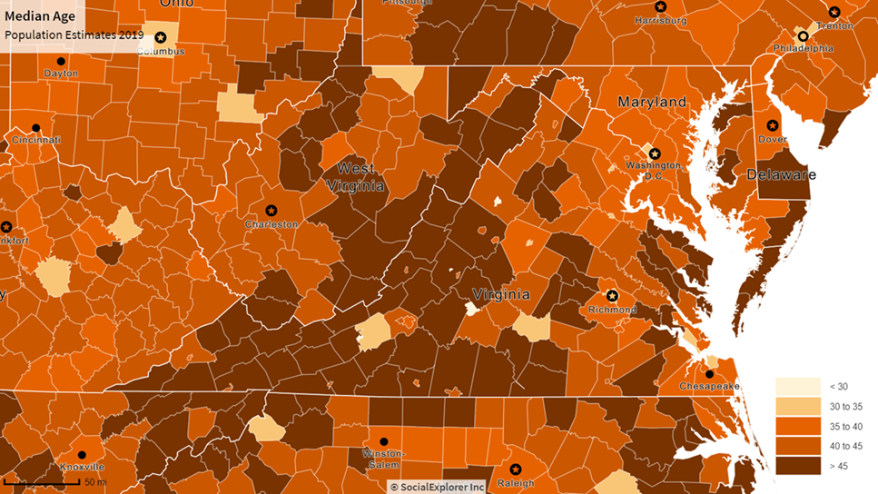
Prior to 2020, Virginia’s age distribution was growing more polarized
Median Age 1980
Median Age 2019

Slide 19
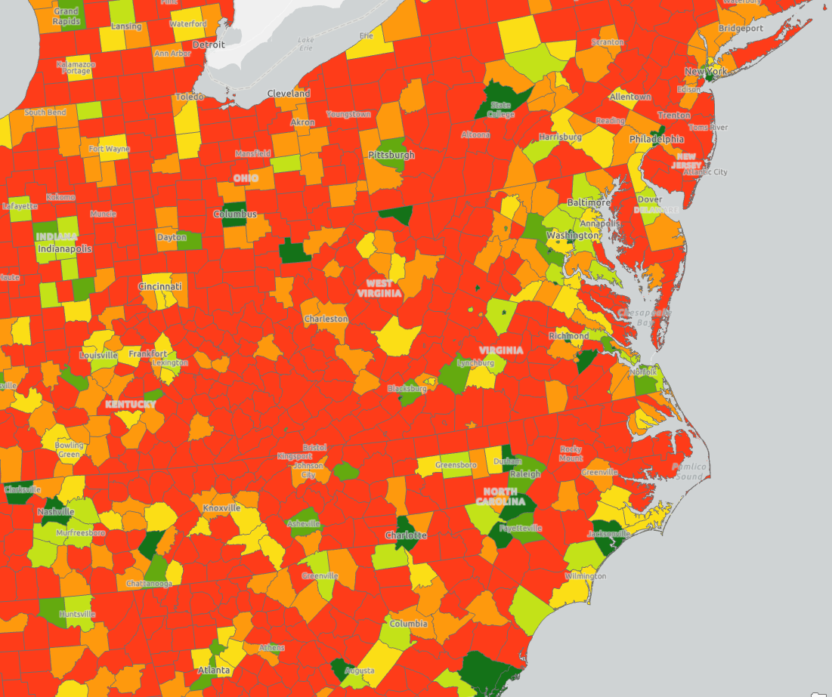
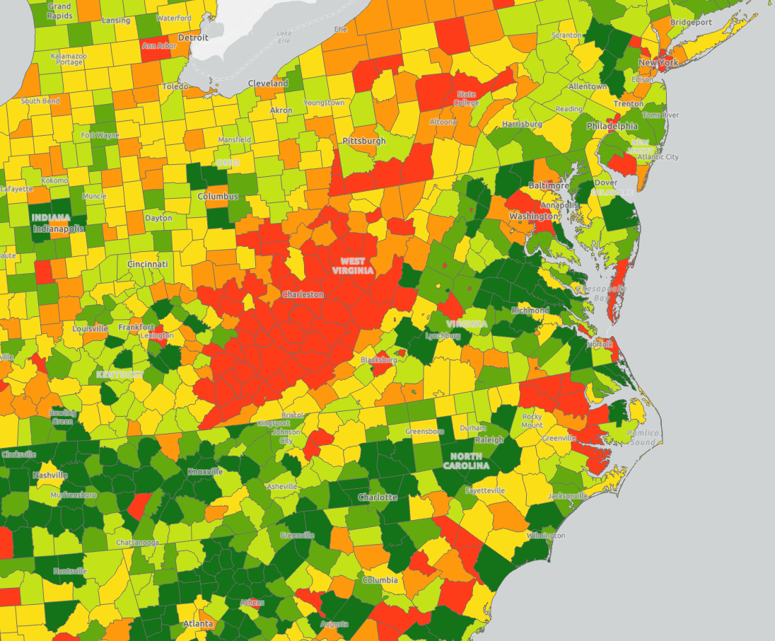
Current migration trends are transforming Virginia’s communities
Percent Change between 2010 and 2013, Age 25 to 44
Percent Change between 2020 and 2023, Age 25 to 44
Declined over 2 Percent
Declined 0 to 2 Percent
Grew 0 to 2 Percent
Grew 2 to 4 Percent
Grew 4 to 6 Percent
Grew over 6 Percent

Slide 20
Examining the Shift in Virginia's Population Trends Since 2020
Virginia Housing Commission
July 15, 2024
Hamilton Lombard, University of Virginia
hamilton.lombard@virginia.edu

